Slide 1
Forms and structural directives
Hardeep Kaur Dhalla

Slide 2
Objectives
FormBuilder service
FormArray service
Custom validation in angular forms
Create a custom attribute directive

Slide 3
Use of Form Builder
In reactive forms we can use FormBuilder service to create a form object.
Use the following steps to take advantage of this service.
Import the FormBuilder class.
Inject the FormBuilder service.
Generate the form contents.

Slide 4
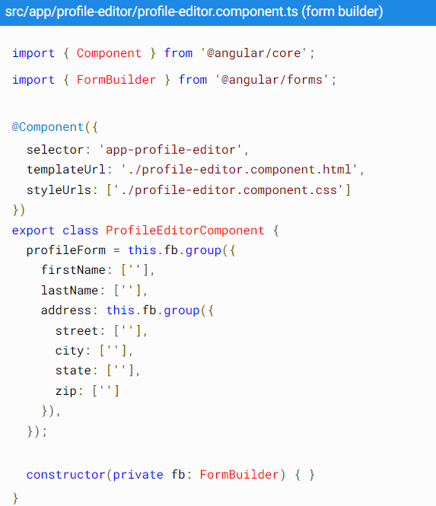
Form Builder service

Slide 5
FormArray class
FormArray is an alternative to FormGroup for managing any number of unnamed controls.

Slide 6
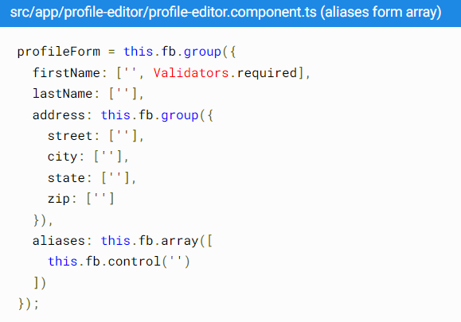
FormArray class
If you are using Formbuilder service then Use the FormBuilder.array() method to define the array, and the FormBuilder.control() method to populate the array with an initial control.

Slide 7
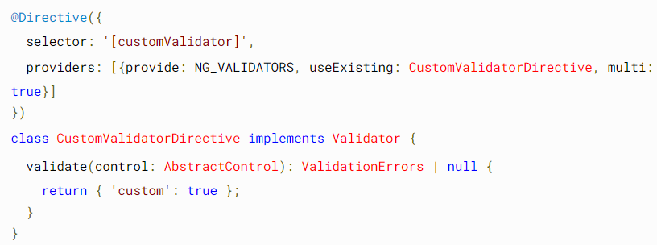
Form custom validation
Adding custom validators to template-driven forms:
In template-driven forms, add a directive to the template, where the directive wraps the validator function.
Angular recognizes the directive's role in the validation process because the directive registers itself with the NG_VALIDATORS provider, as shown in the following example.

Slide 8
Form custom validation in reactive forms
Write a regular function and add validation logic
Next step is to use this function as shown below:
In template:

Slide 9
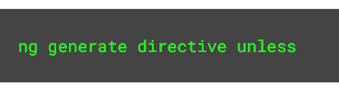
Create a structural directive
Command to create a structural directive:

Slide 10
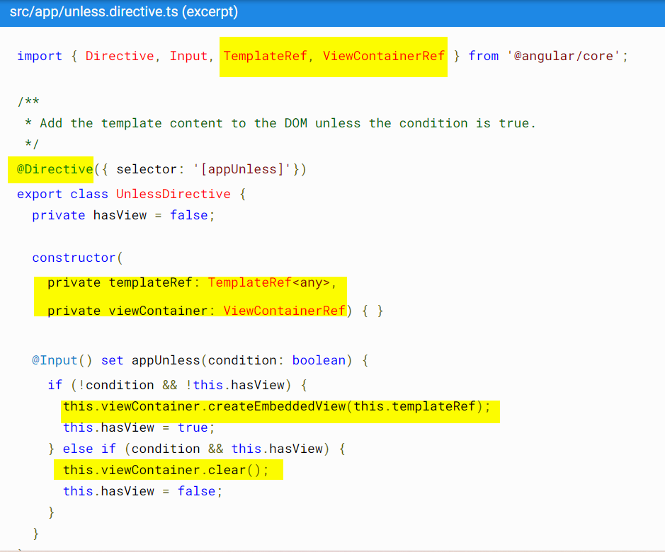

Slide 11
References
https://angular.io/guide/form-validation
https://angular.io/guide/structural-directives#creating-a-structural-directive

